Slide 1

Debugging models
This section will introduce you to the model debugging tools in GridLAB-D

Slide 2
Two debuggers
Model debugger (gld)
  Access simulation controls
  View object and properties
  Monitor/change objects/properties
  Integrated with GridLAB-D solver
Code debugging (gdb/msvc)
  Full featured debugging on runtime classes
  Requires additional software installs

Slide 3
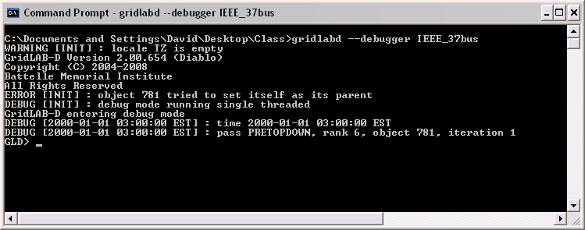
GridLAB-D Debugger

Slide 4
GLD Commands
Break – sets a breakpoint
Watch – sets a watchpoint
List – list objects
Run – starts the simulation
Next – steps to the next breakpoint
Print – displays an object
Set – sets an object property
Where – shows where the simulation is
Globals – list global variables
Help – list these and other commands
<Ctrl-C> – stops running simulation

Slide 5
Break
Clock – stops when the clock advances
Error – stops on an error message
Object X – stops on object X
Module X – stops on module X
Class X – stops on class X
Pass X – stops on pass X
Rank X – stops on rank X
Time X – stops at time X
Disable/enable # - controls breakpoints

Slide 6
Watch
X – stops if object X changes
X Y – stops if object X property Y changes
Sync – control sync watch

Slide 7
List
Short form (details off)
FLAGS rank clock name parent
Long form (details on)
... XFLAGS module/class/id
FLAGS [1 2 3 4 5 6] XFLAGS [7 8 9]
  [1] Service status A=active, P=pending, R=retired
  [2-4] Pass sync status (LC=pending, UC=done, -=none)
  [5] Lock status (l=active, -=none)
  [6] PLC status (x=active, -=none)
  [7] Recalc status (c=pending, -=none)
  [8] Rerank status (r=pending, -=none)
  [9] Foreign status (f=active, -=none)

Slide 8
Set
Syntax: set object property value
Value must be appropriate to property type
Change take effect immediately
Globals can be set
set global name value
Module globals use module name
set global module::name value

Slide 9
Exercises
Debug the IEEE 37 bus model
List the objects
Enable details and list again
Add a break point on an object and run
Disable the break, add a watch and run

